Slide 1


11th Collaboration Meeting of the BM@N Experiment at the NICA Facility
Interactive Visualization of Simulation and Experimental Event Data for BM@N
Anastasiia Iusupova, Saint Petersburg State University
25.11.2023
st099003@student.spbu.ru

Slide 2
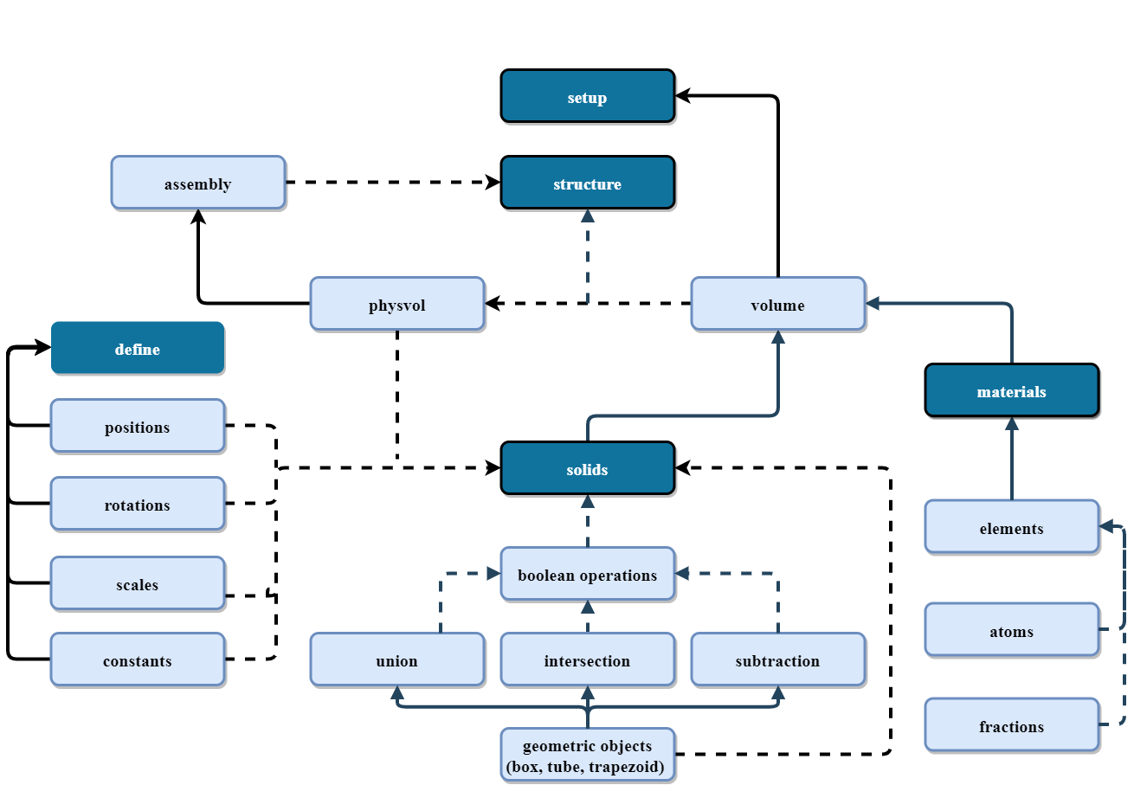
Previous results
Virtual Reality (VR) simulates the user’s physical presence in a virtual environment
The detector geometry was exported to Unity using GDML macro for converting GDML into a C# script for import into Unity
The paper “Geometry import into virtual reality visualization engine for HEP experiments at BM@N” is at the second stage of review in Nuclear Inst. and Methods in Physics Research, A
Fig. 1 – Detector geometry hierarchy structure

Slide 3
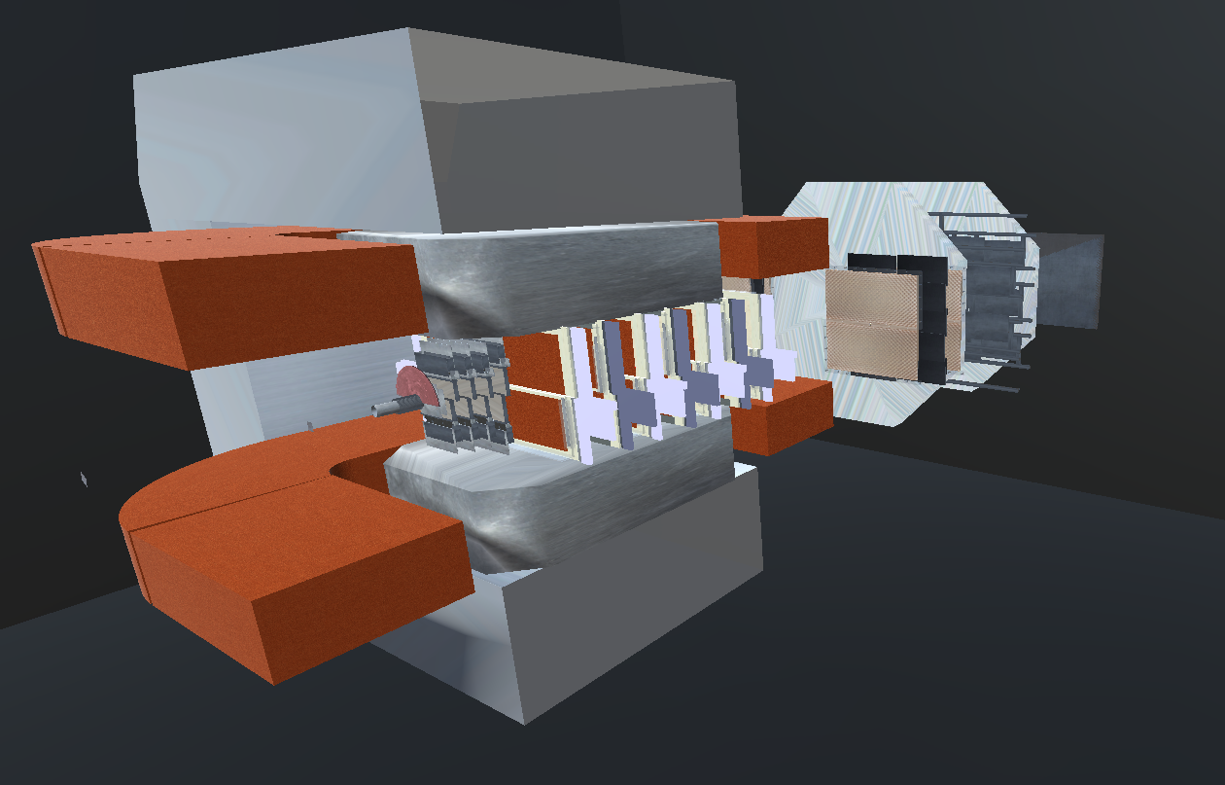
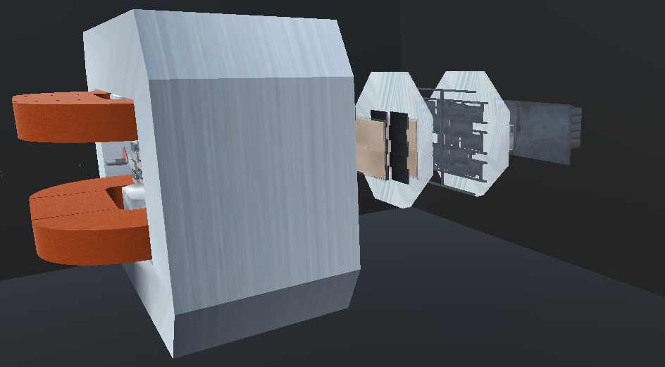
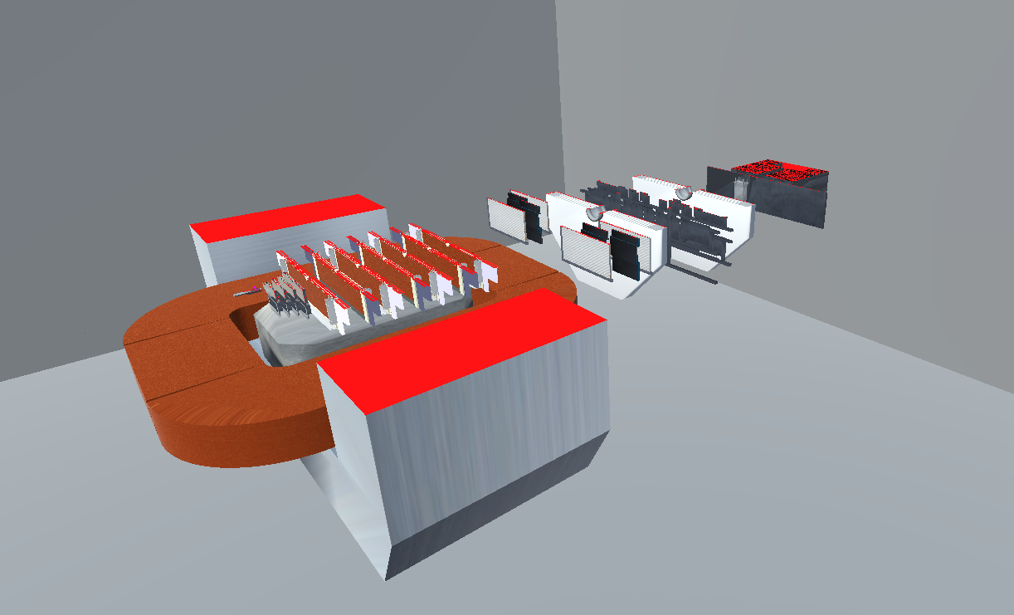
View of imported geometry
Fig. 2 - Transferred geometry of the BM@N experiment in Unty and its inner content (updated for geometry version 8)

Slide 4
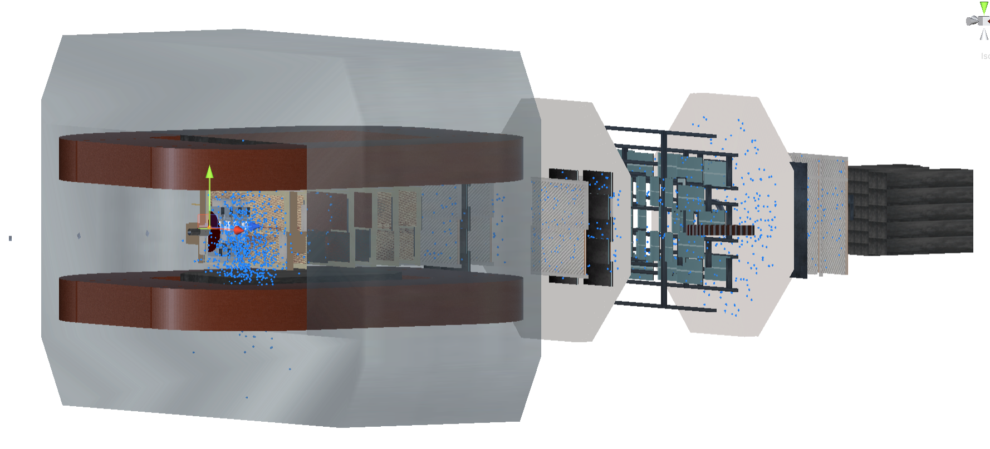
Export events, tracks, and points from simulation
Event includes:
event ID data,
vertex,
tracks
Track includes:
track ID data,
mother ID,
vertex,
PDG (Particle Data Group) code,
Start time
points
Point includes:
position,
out position,
length from start,
point ID,
detector type,
time of flight
Fig. 3 – Tracks and hits imported to Unity (1000 events)

Slide 5
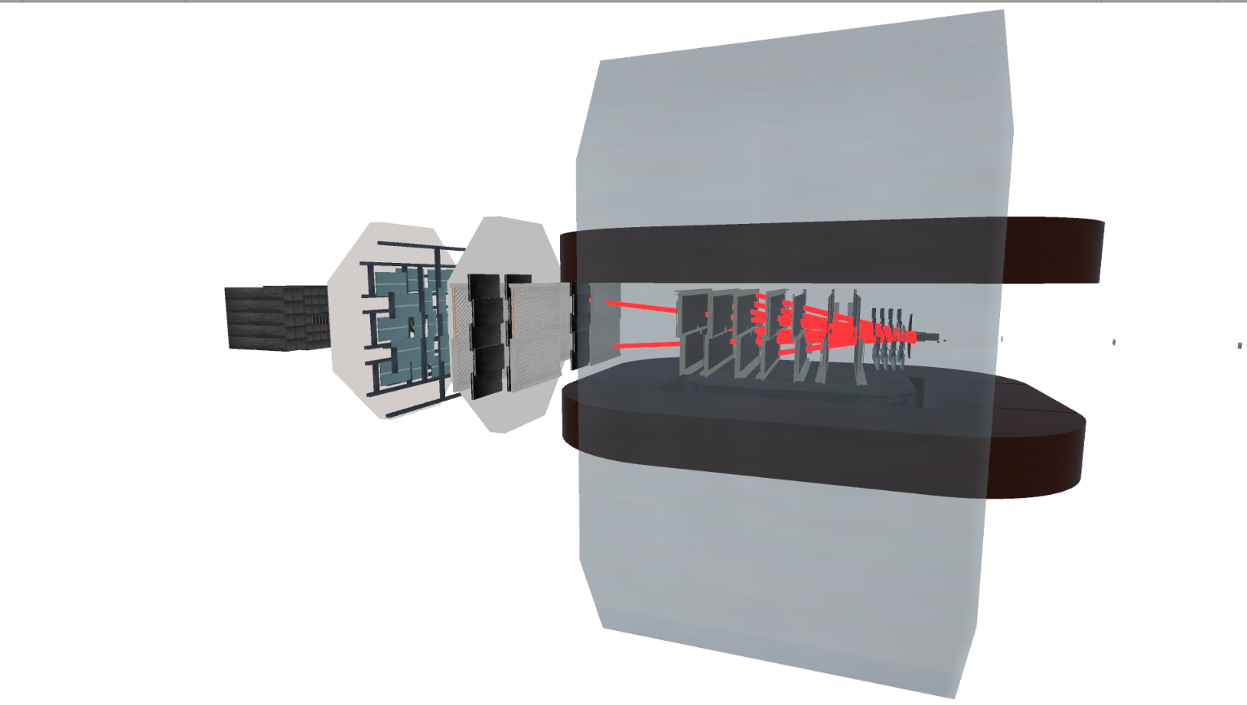
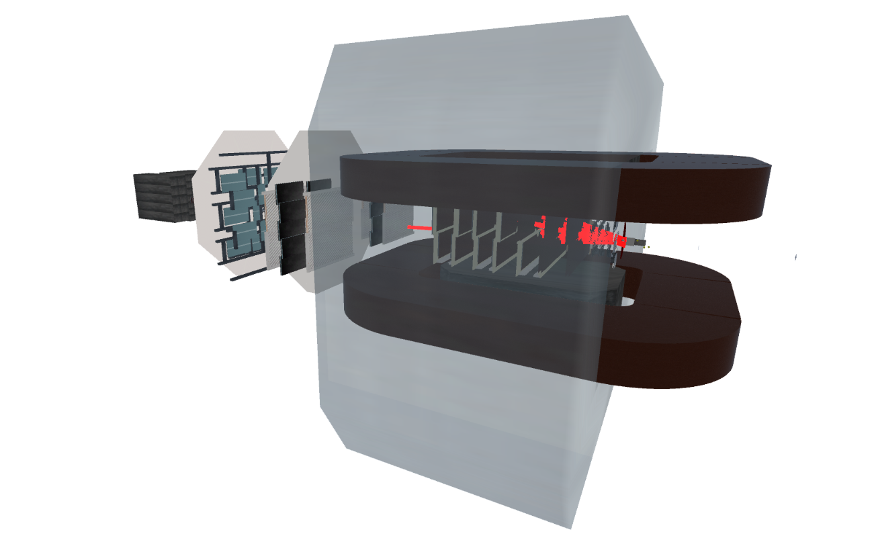
Export tracks and points from reconstruction: global track
XYZ start coordinates
Tx and Tz start data
Qp start
XYZ end coordinates
Tx and Tz end data
Qp end
Fig. 4 – Bmn global track imported to Unity

Slide 6
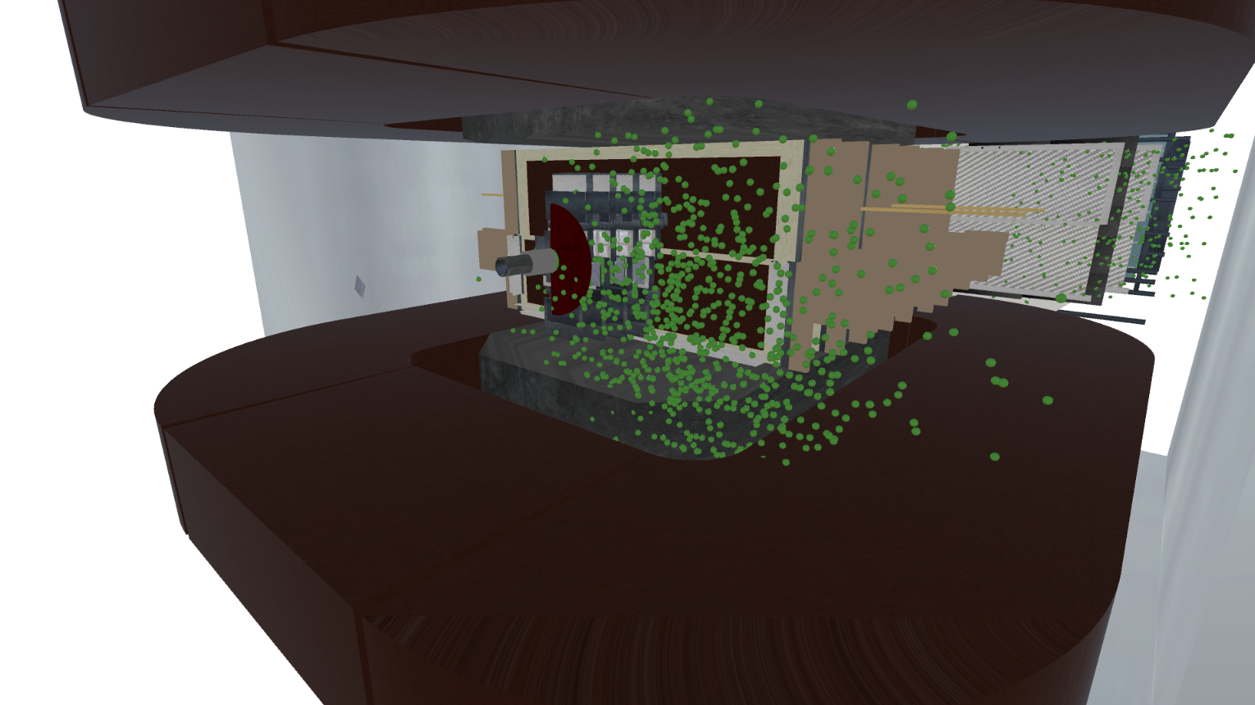
Export tracks and points from reconstruction: points
Fig. 5 – Exported events data
XYZ start coordinates
Tx and Tz start data
Qp start
XYZ end coordinates
Tx and Tz end data
Qp end

Slide 7
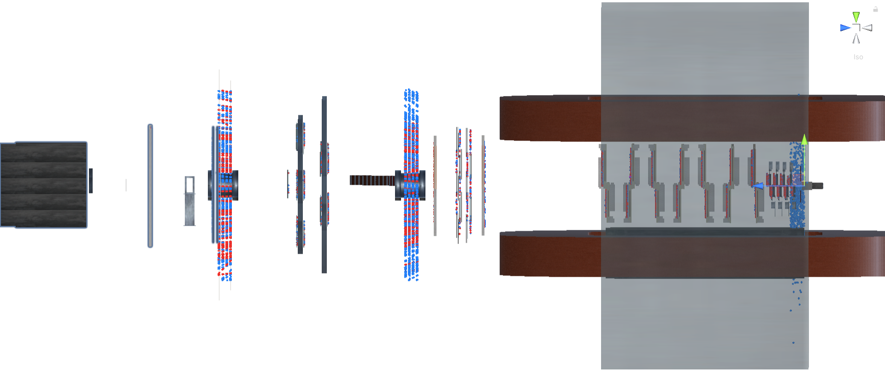
Comparison of simulated and reconstructed data
point and track data
Fig. 6 - For some detectors there is a bias for both simulated and detected points
Simulated and detected points are correspond

Slide 8
Future work
GUI elements: object selection and manipulation
Displaying information about events, particles:
Particle mass, energy
Tome of flights
Additional information
Process animation
Tracks hierarchy visualization
Integration with BmnROOT environment

Slide 9
Thank you for the attention!
11th Collaboration Meeting of the BM@N Experiment at the NICA Facility
Anastasiia Iusupova
st099003@student.spbu.ru
Работа выполнена при поддержке Программы целевого финансирования
научно-исследовательских работ научных групп, сотрудничающих в рамках мегапроекта «Комплекс NICA»

